Slide 1
Applications of Information & Communication Technology
Mr. Ali Haider
Institute Of Management Sciences

Slide 2
CLI vs GUI
The age-old debate: GUI vs CLI! Both are used for interacting with computers, but they differ in their approach. GUI, or Graphical User Interface, uses visual elements like windows, icons, and menus to facilitate interaction. On the other hand, CLI, or Command-Line Interface, relies on text-based commands and syntax to manage files, directories, and applications. GUI is more user-friendly and ideal for beginners, while CLI offers more control and flexibility for power users and developers. Ultimately, the choice between GUI and CLI depends on personal preference, familiarity, and specific use cases.

Slide 3
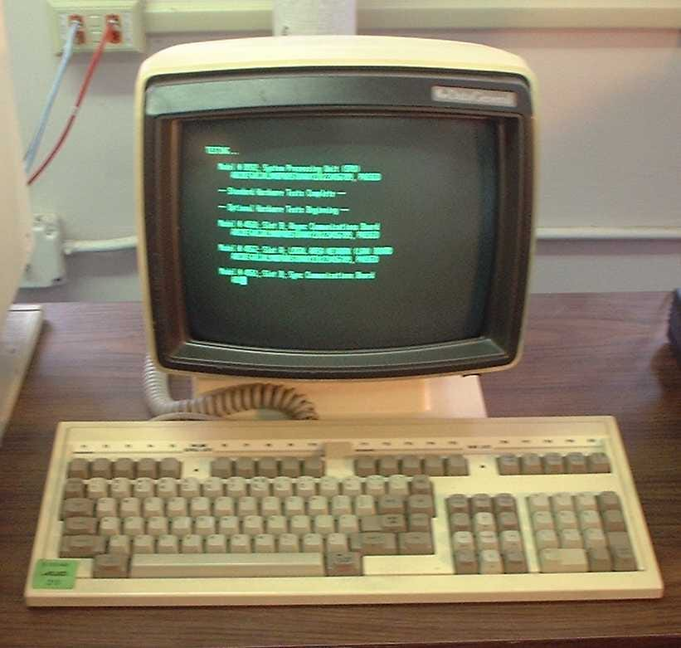
Command Line Prompt
CMD (Command Prompt) is a command-line interpreter application available in most Windows operating systems.
It allows users to interact with the operating system using text-based commands.

Slide 4
How to access CMD
Type “cmd” in the start menu.
Press “shift+F10” and click on “open in terminal”.
Press “window key+R”, type “cmd” and press ENTER.

Slide 5
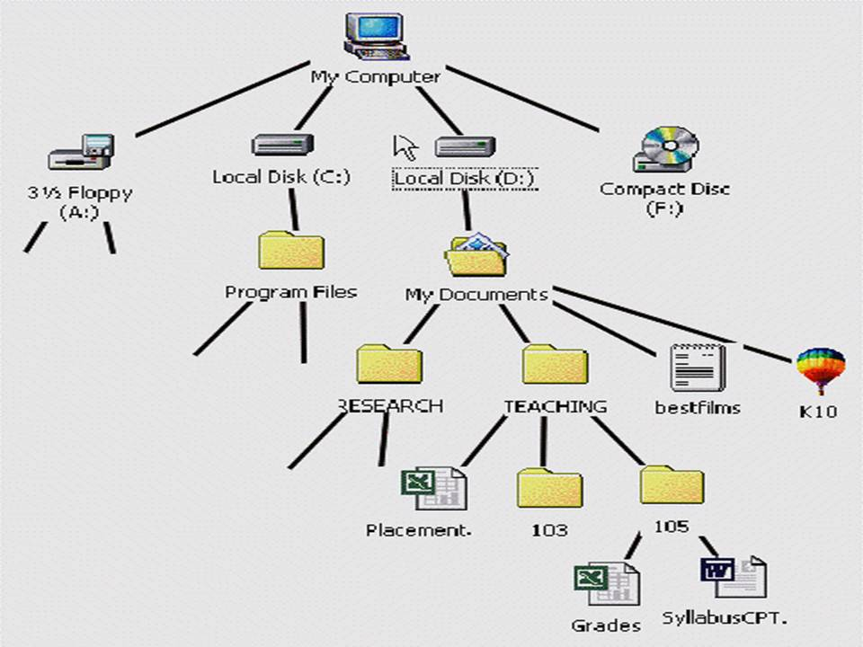
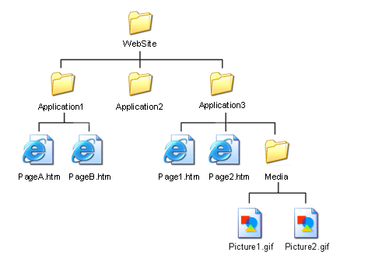
Directory Tree

Slide 6
Files vs Directories
Files and directories are two fundamental concepts in computing. A file is a collection of data stored on a computer, which can be a document, image, audio, or video file. It has a unique name and is stored in a specific location on the computer's hard drive or solid-state drive.
A directory, also known as a folder, is a virtual storage unit that holds and organizes files within a hierarchical structure. Directories can contain subdirectories, allowing for efficient organization and retrieval of files. Understanding the distinction between files and directories is crucial for effective computer management and maintenance.

Slide 7
We will learn in this Lab how to:
Navigate directories using cd and dir.
Manage files and folders with mkdir, rmdir, copy, move, and del.
Use cls to clear the screen and exit to close CMD.

Slide 8
CMD Commands
dir ( shows directories )
dir /p (page by page)
cd ( change directories )
cd ..
cd ../..
mkdir (make directory)
rmdir (remove directory)
rmdir /s (remove directory and all of its contents)
Notes:
/s: This option tells CMD to remove the specified directory and all its contents, including subdirectories and files (not just empty directories).

Slide 9
copy (copy files and directories)
move (move files and directories)
Command: copy (or) move [source] [destination]
Echo “ Context” > file.txt
Del (delete files)
cls (clear screen)
exit (close cmd)

Slide 10
Thank You.
The End

